Slide 1
k.sashank
SECURE DATA HIDING IN IMAGES USING STEGANOGRAPHY
Presented By: EDUNET (AICTE)
Student Name : K.SASHANK
College Name & Department : GITAM (VIZAG) CSE (AIML)

Slide 2
OUTLINE
Problem Statement
Technology used
Wow factor
End users
Result
Conclusion
Git-hub Link
Future scope

Slide 3
ProbLEm Statement
TO ENCYPT THE DATA
TO PROTECT THE PERSONAL INFORMATION OF THE USER FROM THE HACKERS
TO CREATE A PROCEDURE OF DATA TARANSFER WHICH IS HIGHLY SECURED AND CANT BE ABLE TO BREAK THE ETHICS OF THE TRANSFER PRACTICES
TO CREATE SECURED RELATION OF DATA TRANSFER BETWEEN THE USER AND RECIEVER

Slide 4
Technology used
Library | Purpose
cv2 (OpenCV) | Used for image processing (reading, modifying, and saving images).
os | Used to execute system commands (e.g., opening the encrypted image).
numpy | Used to handle image data arrays efficiently (ensuring pixel values are valid).

Slide 5
Wow factors
Steganography (Data Hiding in Images)
The message is hidden inside the pixel values of an image using RGB channels.
Character Encoding & Decoding
ASCII values of characters are stored in image pixels
Steganography: Hiding Data in Images
Your message is hidden inside an image’s pixel values! Instead of storing text in a file, this technique embeds characters into RGB pixel values, making it almost impossible to detect without the correct decryption method.

Slide 6
End users
Cybersecurity Enthusiasts & Ethical Hackers
Digital Artists & Content Creators
Intelligence Agencies & Military Communication
Software Developers & Security Researchers

Slide 7
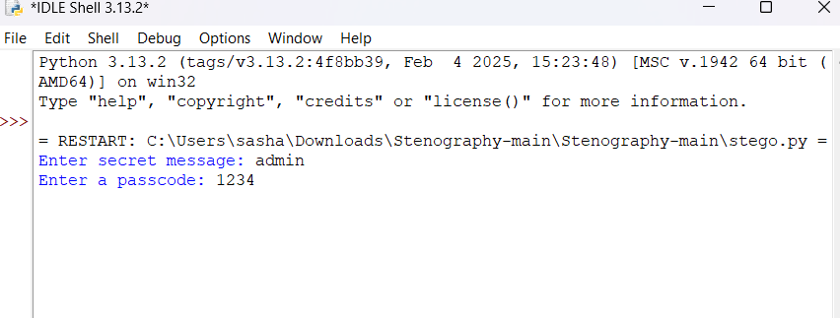
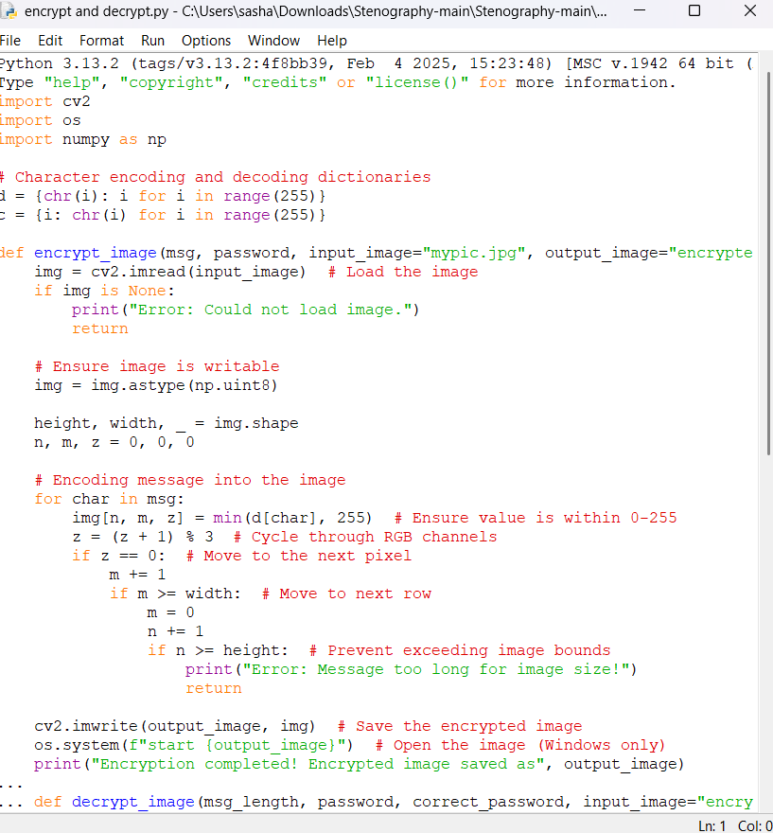
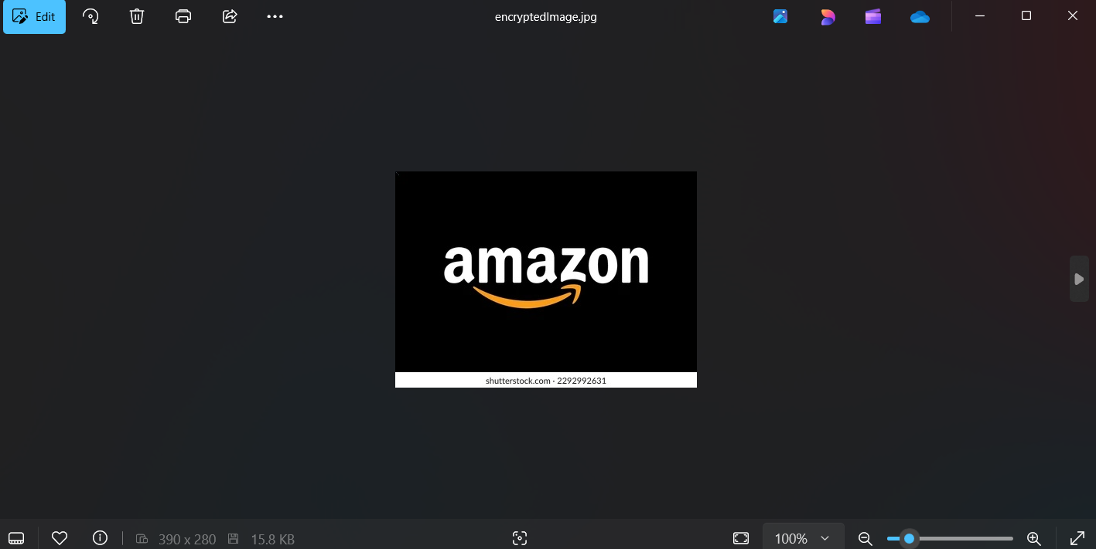
Results

Slide 8
Conclusion
This code successfully demonstrates image-based steganography for secure and discreet communication. By leveraging OpenCV, NumPy, and character encoding, it enables covert data embedding without raising suspicion. With passcode protection, the system ensures that only authorized users can decrypt the message. This technique has real-world applications in cybersecurity, forensic analysis, journalism, and secure communication.
Future Enhancements:
GUI-based user interface for ease of use
AI-assisted pixel selection for better security
Encryption of message length to avoid pattern detection

Slide 9
GitHub Link
https://github.com/sashankkolachina/steganography.git

Slide 10
Future scope(optional)

Slide 11
THANK YOU

